Slide 1
Excursions
Michael Keyton

Slide 2
Madeline Schiller and Piotr Ilyich Tchaikovsky

Slide 3
Nicolas Slonimsky and Grody
Baker’s Biographical
Dictionary of Musicians

Slide 4
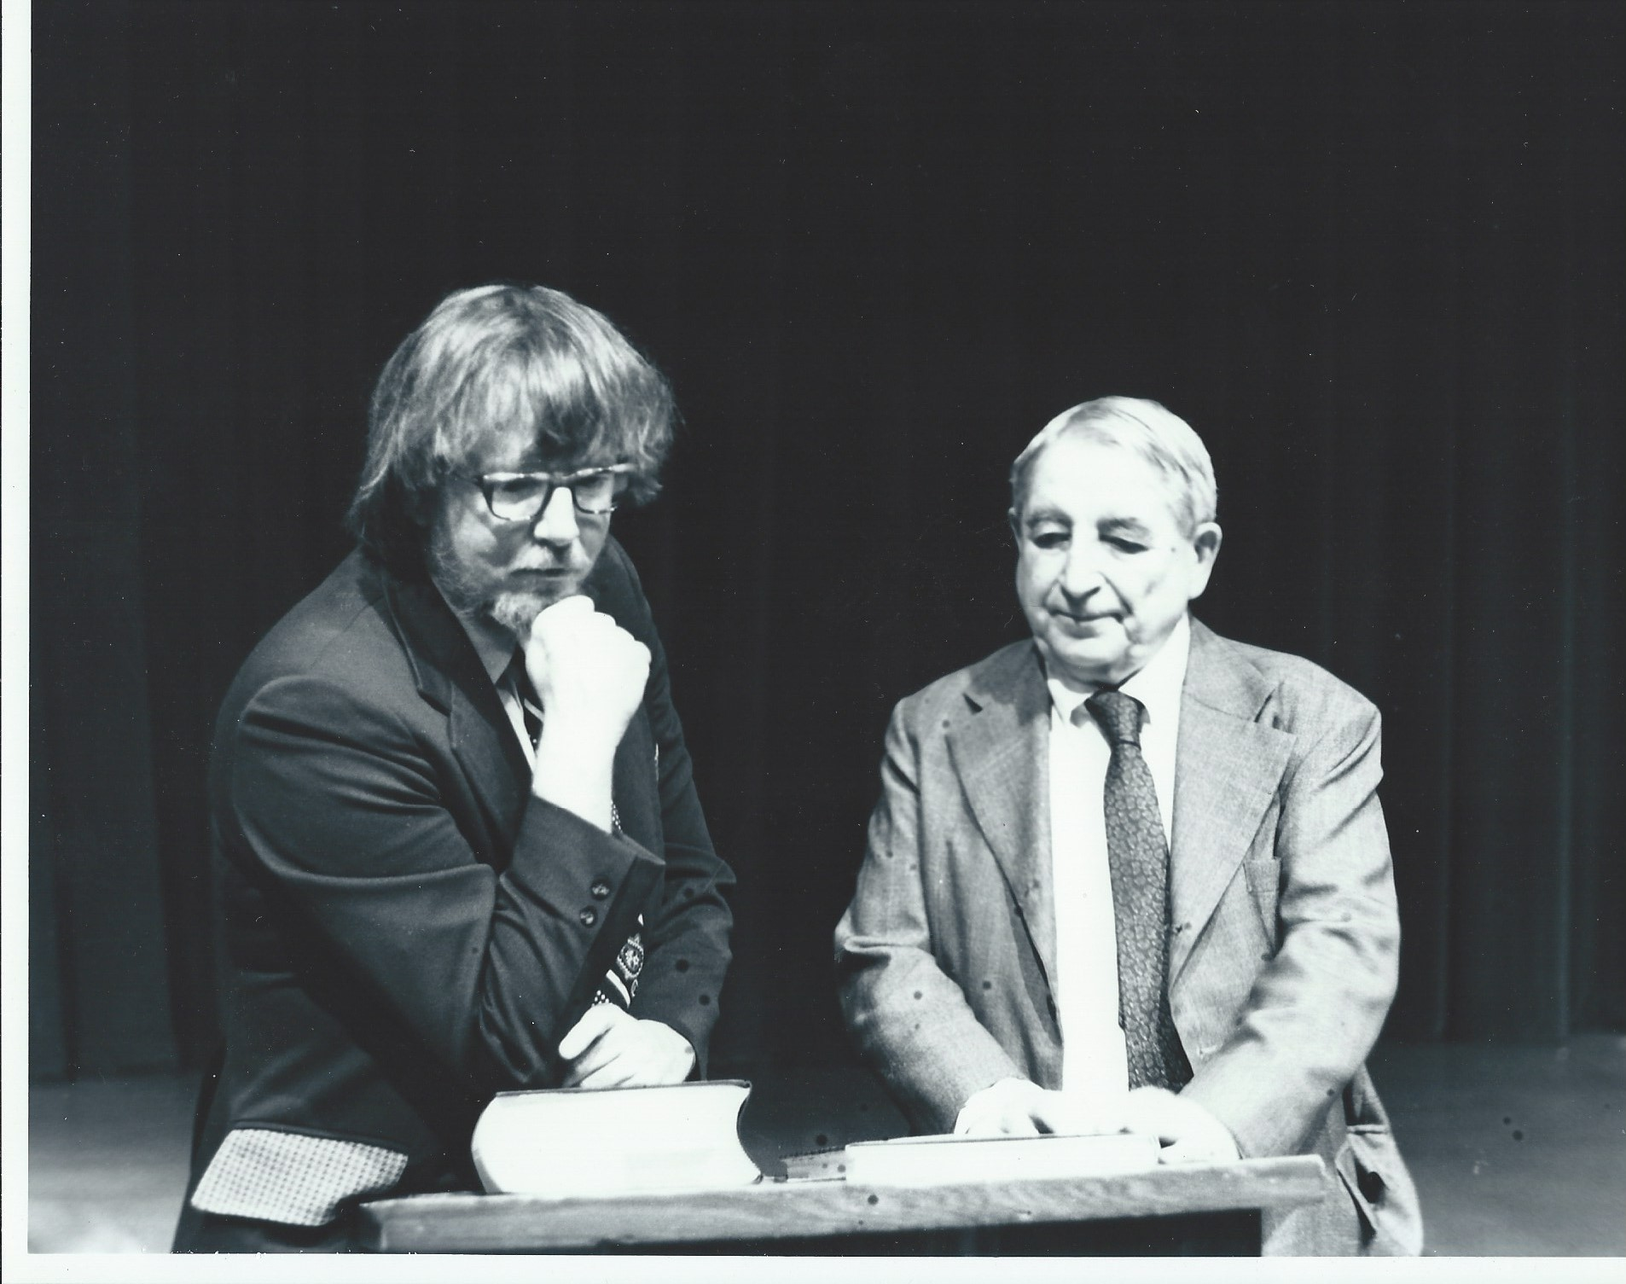

Slide 5
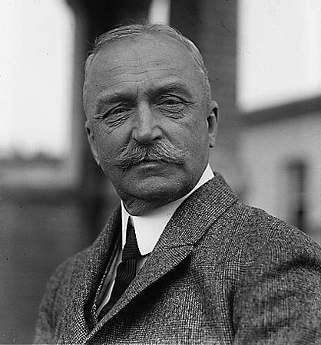
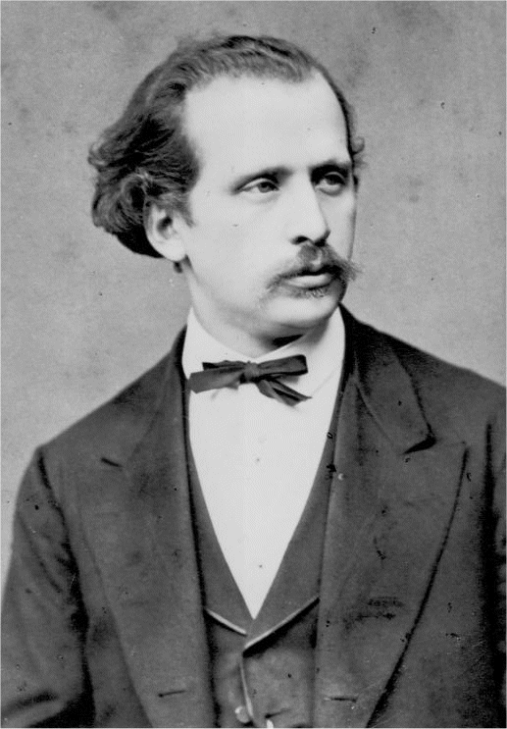
Hans von Bülow
Nikolai Rubinstein

Slide 6
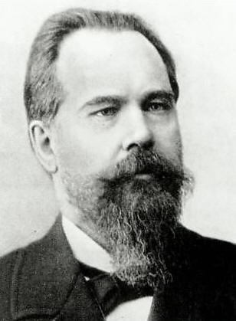
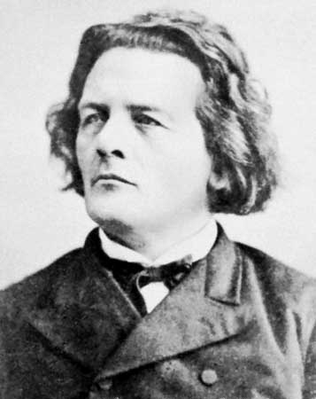
Sergei Taneyev
Anton Rubinstein

Slide 7
New York Times: November 13, 1881
The performance last evening was begun with Brahm’s new overture, tragic, op. 81, followed by a new concerto by Tschaikowski, No. 2, op. 44, in three movements, most admirably played by Mme. Madeleine Schiller. …
She is one of the very few feminine pianists who are entitled to rank as artists, and make no demands on the sympathies of her hearers by reason of the supposed physical weakness of her sex.

Slide 8
Tchaikovsky: Piano Concerto Nr. 2
New York Philharmonic Moscow
November 12, 1881 May 18 (30), 1882
Madeline Schiller Sergei Taneyev

Slide 9
Madeline Schiller
Ny-e-by-lit-sa: un-was-ity
1) [Sexist] How did a female play it?
2) How did Schiller get the score?
3) How did she learn it so quickly?
4) Why is there no mention of the trio?
5) Why is there no mention of 92 keyboard piano?
6) Story of the premiere is in every reference to Tchaikovsky!
7) Who was Schiller? Why hadn’t I heard of her?

Slide 10
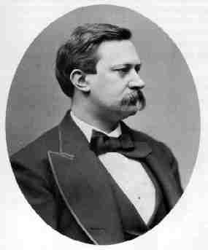
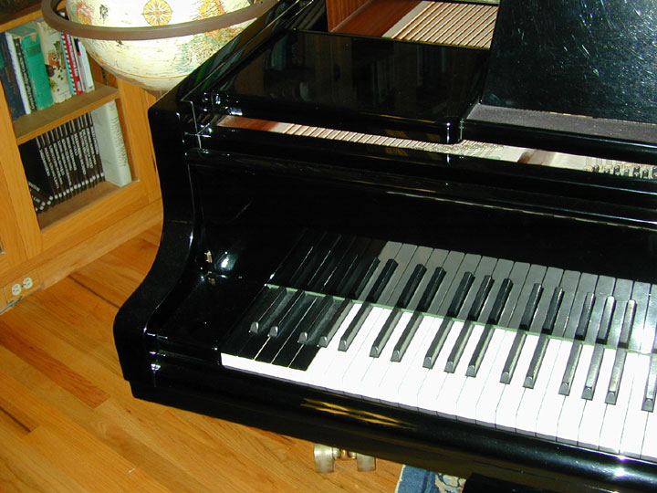
Theodore Thomas
Piano with 92 keys

Slide 11
And then there’s Keyton-he’s a mathematician, who somehow
became fascinated with the soloist who gave the world premiere
of Tchaikovsky’s Second Piano Concerto, in New York City, in 1881,
an otherwise insignificant pianist named Madeline Schiller.
One day, he happened upon a picture of her in a newspaper of the period,
he fell hopelessly in love with her, and since then he’s managed to unearth
over a hundred articles about the woman.
I mean, these are the kinds of madmen I run with.
New Yorker, Nov. 24, 1986, p. 64

Slide 12
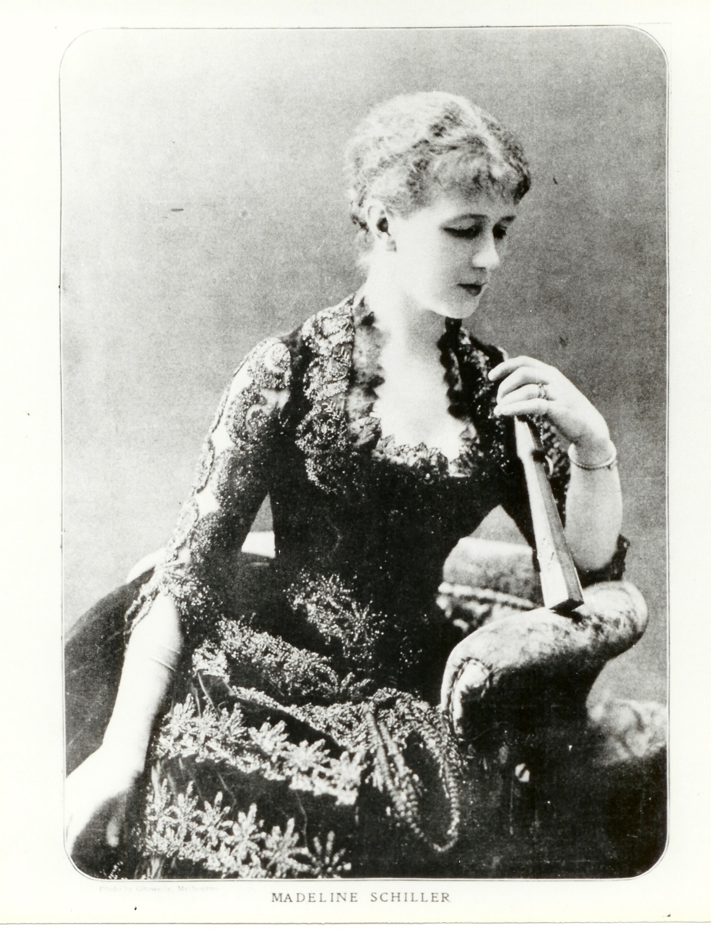

Slide 13
O! Call back yesterday, bid time return.
Shakespeare: Richard III

Slide 14
Sources:
Keyton, Michael, "Madeline Schiller", Music & Musicians, May 1987.
http://en.wikipedia.org/wiki/Madeline_Schiller
http://en.wikipedia.org/wiki/Piano_Concerto_No._2_%28Tchaikovsky%29
http://wiki.tchaikovsky-research.net/wiki/Piano_Concerto_No._2

